Slide 1

Part-A
Unit-1
INTRODUCTION
Data Communications
Networks
The Internet
Protocols and Standards
Layered tasks
The OSI Model and the layers in the OSI model
TCP / IP Protocol Suite

Slide 2
1.1 Data Communications
It is the exchange of data between two devices via some form of transmission medium such as a wire cable.
The effectiveness of a data communications system depends on 4 characteristics:
Delivery
Accuracy
Timeliness
Jitter

Slide 3
Components:
Message
Sender
Receiver
Transmission medium
Protocol
Data Representation
Text
Numbers
Images
Audio
Video

Slide 4
Data flow
Communication between two devices can be of 3 types
Simplex: here the comm is unidirectional. Only one of the two devices on a link can transmit, the other can only receive.
Half-Duplex: Each station can both transmit and receive, but not at the same time.
Full-Duplex: also called duplex, both stations can transmit and receive simultaneously.

Slide 5
1.2 NETWORKS
A network is a set of devices (nodes) connected by communication links.
Distributed processing is one in which a task is divided among multiple computers.
Network Criteria: it must meet certain number of criteria.
Performance: include transit time and response time.
Reliability: it is measured by frequency of failure.
Security: protecting data from unauthorized access, damage and development, data losses.

Slide 6
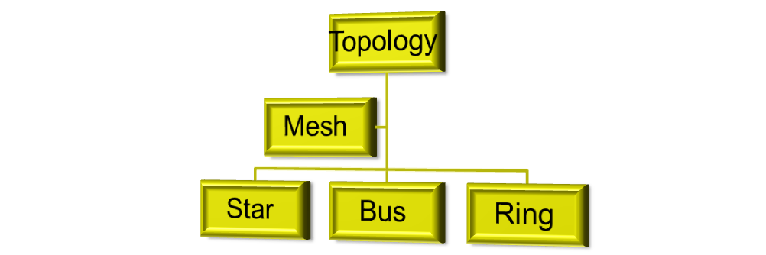
3. Physical structures
Type of connection:
Point-to-point: provides a dedicated link b/w two devices.
Multipoint: (multidrop) is one in which more than two specific devices share a single link.
4. Physical Topology: 2 or more devices connect to a link; 2 or more links form a topology.

Slide 7
Mesh topology: Every device has a dedicated point-to-point link to every other device.
We need n(n-1)/2 duplex-mode links.
Advantages are since it carries its own data load it eliminates the traffic problems, it is robust, it provides privacy or security, it makes fault identification and fault isolation easy.
Disadvantages are installation and reconnection are difficult, the sheer bulk of the wiring can be greater than the available space can accommodate, hardware to connect each link may be expensive.
Ex is c/n of telephone regional offices in which each regional office needs to be connected to every other regional office.

Slide 8
Star topology:
Each device has a dedicated point-to-point link only to a central controller usually called a hub.
The devices are not directly linked to one another.
Unlike a mesh, a star does not allow direct traffic b/w devices.
Controller acts as an exchanger.
It is less expensive & easy to install, configure. It is robust.
It suffers from SPOF.
Ex is it is used in LANs.

Slide 9
Bus topology:
Nodes are connected to the bus cable by drop lines and taps.
A drop line is a c/n running b/w the device and the main cable.
A tap is a connector that either splices into the main cable or punctures the sheathing of a cable to create a contact with metallic core.
Advantages are easy to install, uses less cabling.
Drawbacks are difficult reconnection and fault isolation, a fault or break in the bus cable stops.
Ethernet LANs uses bus topology.

Slide 10
Ring Topology
Each device has a dedicated point-to-point connection with only the two devices on either side of it.
Each device in the ring incorporates a repeater.
Easy to install and reconfigure
Unidirectional traffic is the disadvantage. Dual ring can be followed.
Hybrid Topology
A network can be hybrid. For ex, combining bus and star topology.

Slide 11
5. Network models
Categories of networks:
LAN: speed is 100 or 1000 Mbps.
WAN: Switched and point-to-point WAN
MAN: it may spread over a city or part of a city. Ex is Telephone network.
Internetwork: 2 or more networks connected.

Slide 12
1.3 The Internet
A brief history
The Internet today
International Internet Service Providers
National Internet Service Providers
Regional Internet Service Providers
Local Internet Service Providers

Slide 13
1.4 Protocols and Standards
Protocol: A protocol defines what is, how it is, and when it is communicated. The key elements of a protocol are
Syntax: it refers to structure or format of data, meaning the order in which they are presented.
Semantics: refers to meaning of each section of bits. Ex, does an address identify route to be taken or final destination of the message.
Timing: refers to two characteristics: when data should be sent and how fast they can be sent. Ex, if sender produces 100Mbps but receiver can process only 1 Mbps, transmission will overload receiver and some data will be lost.

Slide 14
Standards
De facto (by fact): It has not been approved by an organized body, but have been adopted as standards through widespread use. This are often established by manufacturers who seek to define functionality of a new product or technology.
De Jure (by law): Those standards that have been legislated by an officially recognized body.

Slide 15
Standards Organizations
Standards creation committees
ISO
ITU-T
ANSI
IEEE
EIA
Forums: present conclusion to standard bodies.
Regulatory Agencies: it is subject to regulation by government agencies such as FCC in US.
Internet Standards

Slide 16
1.5 Layered Tasks
We use the concept of layers in our daily life.
Tasks involved in sending a letter
At the sender site
Higher layer, Middle layer and Lower layer.
On the way
At the receiver site
Lower layer, Middle layer and Higher layer.
Services: OSI Model did not become dominant but TCP/IP became dominant model.

Slide 17
1.6 OSI MODEL
ISO is the organization. OSI is the model.
OSI Model was introduced in late 1970s.
An open system is a set of protocols that allows any two different system to communicate regardless of their underlying architecture.
The purpose of OSI model is to show how to facilitate communication b/w different systems without requiring changes to the logic of underlying h/w and s/w.
OSI is not a protocol, but it is a model.

Slide 18
Layered architecture
There are seven ordered layers.
The processes on each machine that communicate at a given layer are called peer-to-peer processes.
Interface b/w each pair of adjacent layers.
7-layers can be thought of as belonging to 3 subgroups. L-1,2,3 are the n/w support layers. L-5,6,7 are user support layers. L-4 links the two subgroups.
Encapsulation

Slide 19
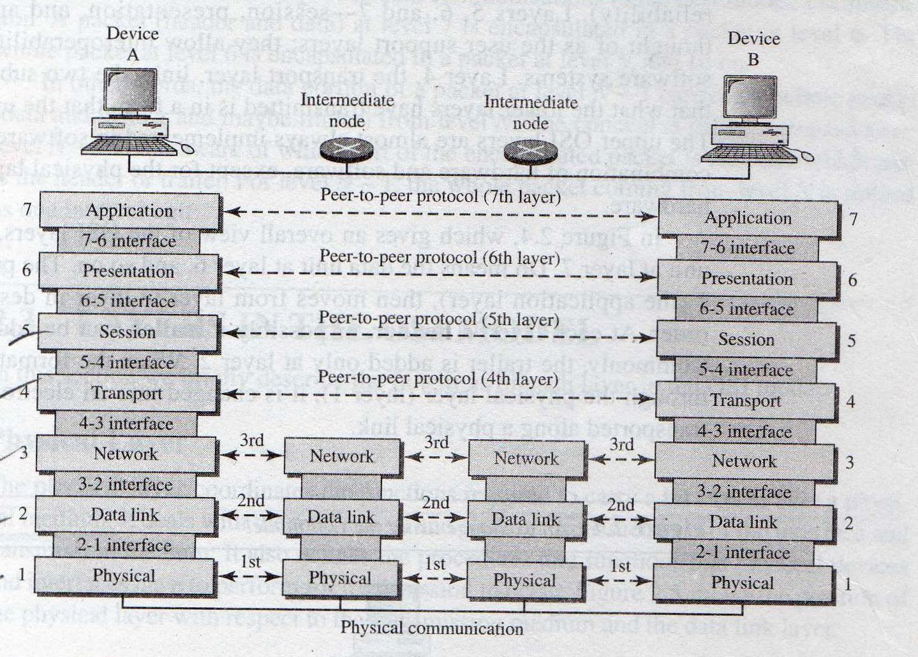
Interaction b/w layers in OSI model

Slide 20
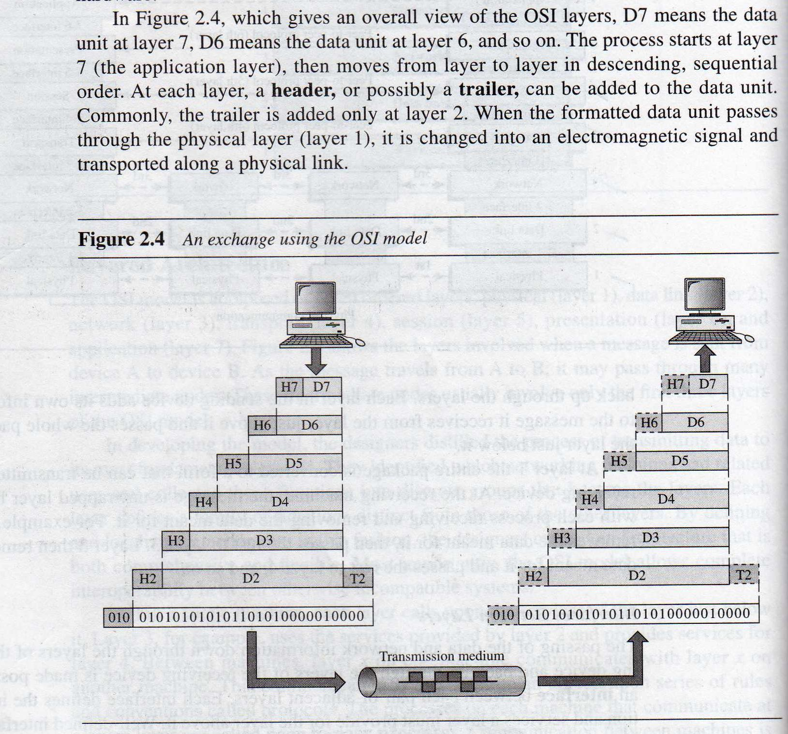
An exchange using OSI model

Slide 21
2.3 Layers in the OSI model
Physical Layer:
It coordinates the functions required to carry a bit stream over a physical medium.
It is concerned with the following:
Physical characteristics of interfaces and medium
Representation of bits – For transmission, bits must be encoded into signals – electrical or optical. PL defines type of encoding.
Data rate – Transmission rate
Synchronization of bits – Clock synchronization
Line configuration – c/n of devices to the media
Physical topology – c/n of devices to form a network
Transmission mode – direction of transmission.

Slide 22
2. Data Link Layer
It transforms a raw transmission facility to a reliable link.
It is responsible for moving frames from one hop (node) to the next.
Other responsibilities are
Framing – DLL divides the stream of bits received from the NL into manageable units called frames.
Physical addressing – sender/receiver add.
Flow control – If absorption of data at receiver is less than the rate at which data are produced by the sender.
Error control – adds reliability to detect and transmit damaged or lost frames, recognize duplicate frames and available in trailer.

Slide 23
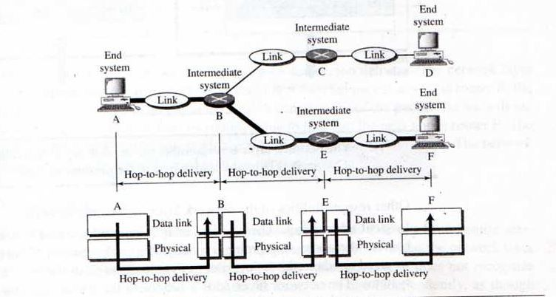
Access control – To determine which device has control over the link at any given time, when there are 2 or more devices.

Slide 24
TO BE CONTINUED

